Slide 1
INFO3315
Project phase 4
G5
Jacky 470011746
Michaela 460047977
Zelin 490444409

Slide 2
Content
Details of experiment
Pilot experiment
Summaries of results
Field study

Slide 3
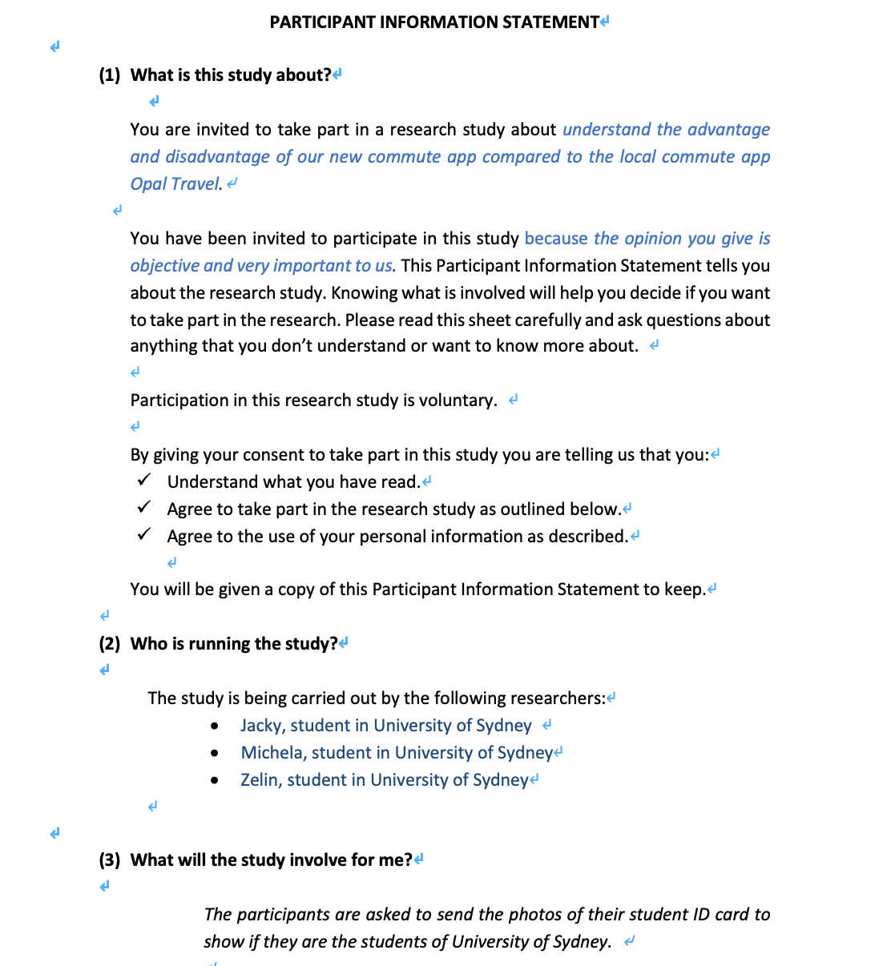
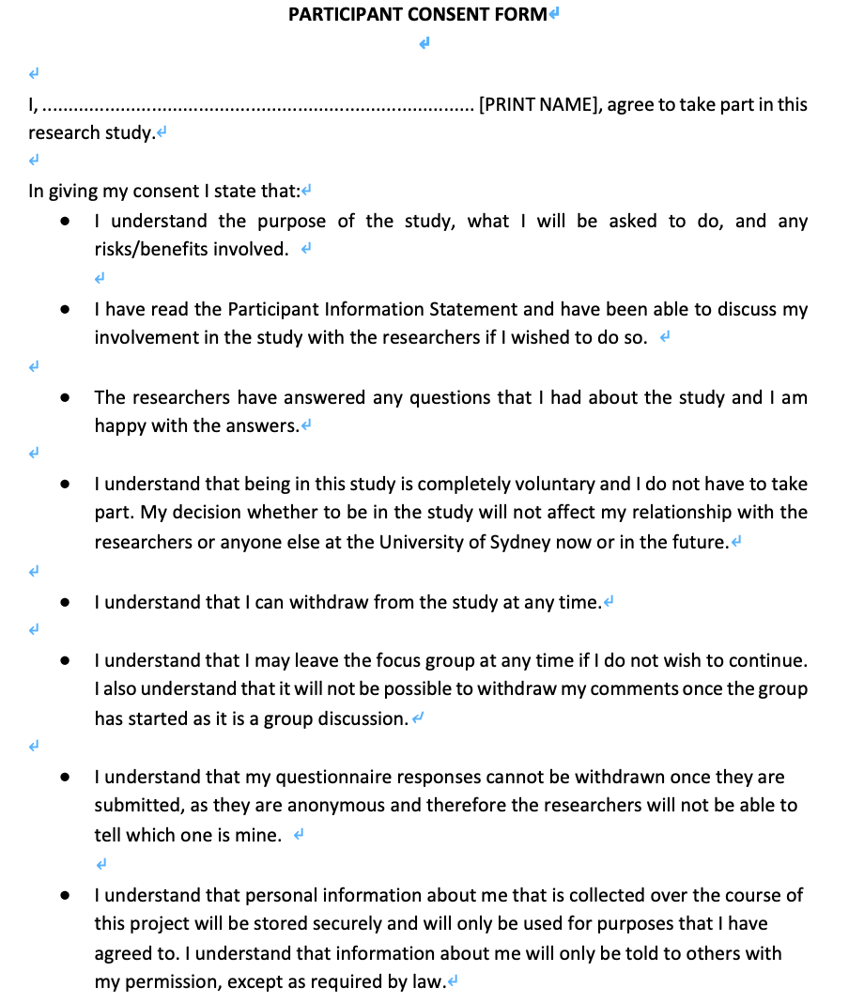
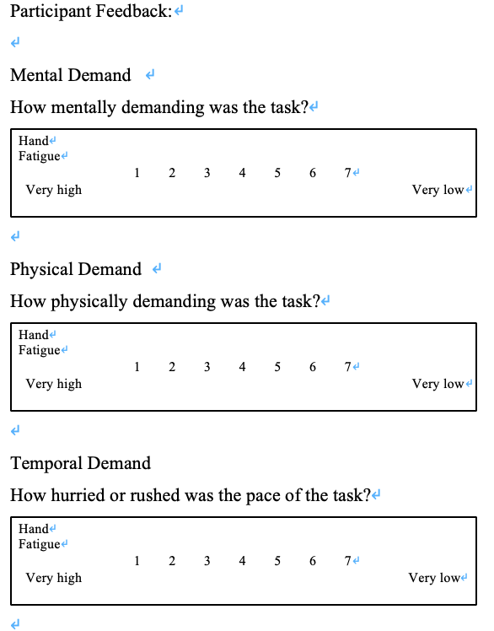
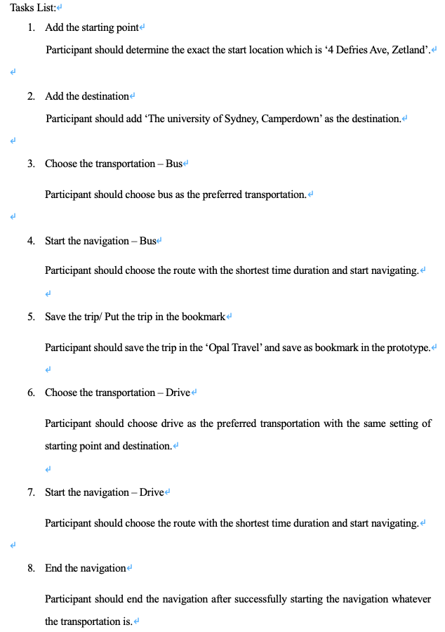
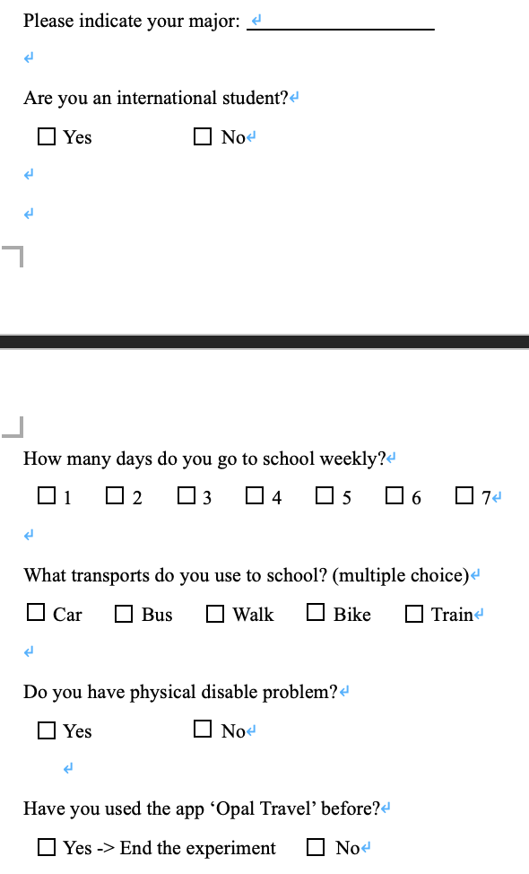
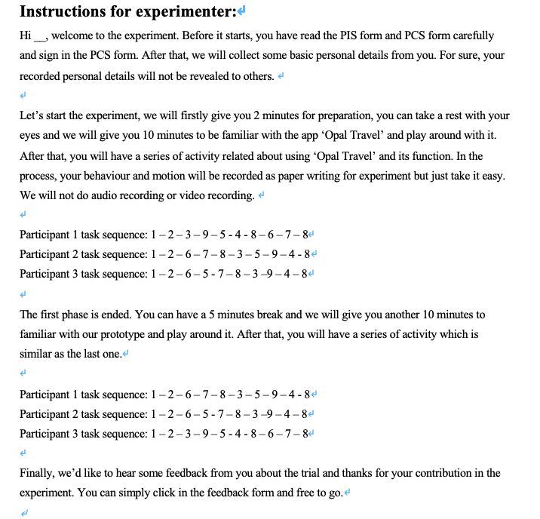
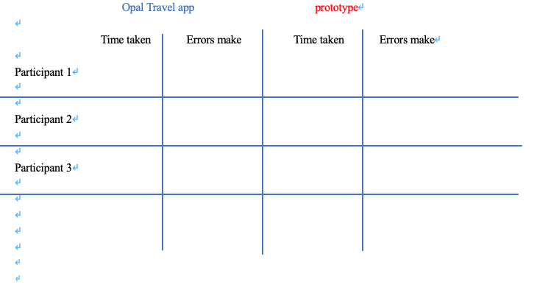
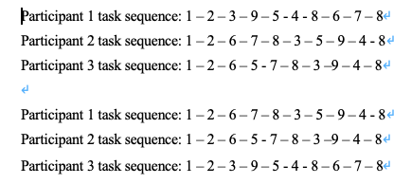
Details of experiment
Participant information statement
Participant consent form
Participant background
Trial
Feedback
Instruction

Slide 4
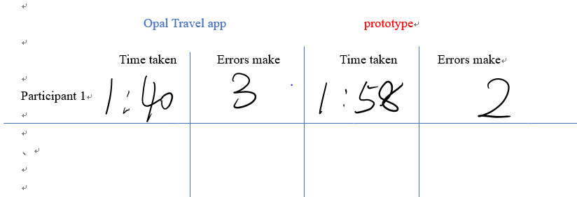
Pilot experiment
Tester: Jacky Experimenter: Michaela
Diﬃculties :
1. It takes time to read PIS and PCF carefully.
2. It is too hurried to be familiar with the system in 5 minutes.
3. The prototype cannot perform as realistic as the completed app

Slide 5
Pilot experiment
Changes made:
•1. Streamline the PCF.
•2. Extend the time for familiar to 10 minutes.
•3. Disorder the sequence of trials for different apps with the participant to ensure the fairness of the experiment.
•4. Add a question in participant background to ensure that the participant has not used ‘Opal Travel’ before.

Slide 6
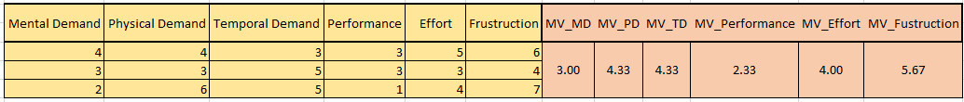
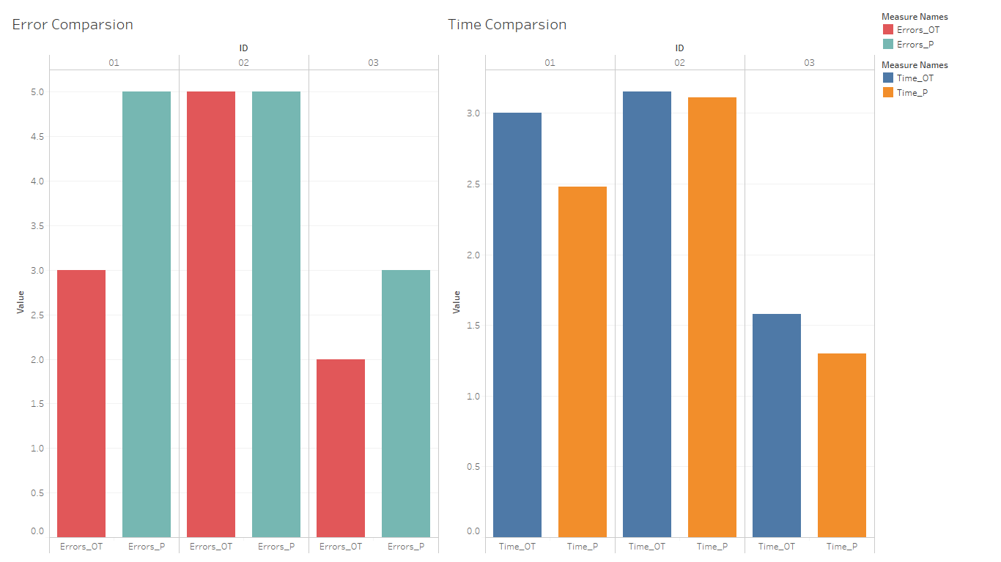
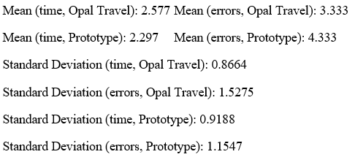
Summaries of results
The experiment is provided as a moderate strength experiment and successful
Prototype: Less time but more errors

Slide 7
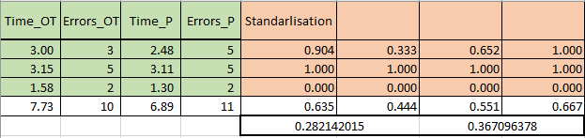
Summaries of results
Standard Deviation (Too few data sets)
X (Efficiency) = T (Time) * E (Number of errors)
Use min-max standardization
The efficiency of using Opal Travel is a bit higher than prototype
Improvement

Slide 8
Field study
Without File Study:
Real time consumed may be bias
The function of navigating cannot be properly tested
The convenience of the application cannot be tested
The interaction function like feedback cannot be tested
The UI problem may be hidden

Slide 9
Thanks for listening！
Any question？

